Slide 1

SNIPE TEAM
14 December 2017
www.snipe.co.in
1
Notes:
1

Slide 2

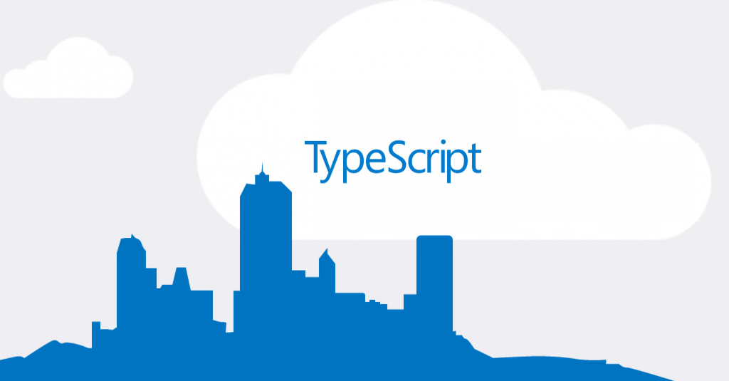
TYPESCRIPT

Slide 3
CONTENTS
INTRODUCTION
HISTORY
WHAT IS TYPESCRIPT
WHY WE USE
FEATURES
TS & ECMASCCRIPT
COMPONENTS OF TS
DECLARATION FILES
ENVIRONMENT SETUP
BASIC SYNTAX
COMPILE & EXE
EXAMPLE
CLASSES
MODULES
CONCLUSION

Slide 4
INTRODUCTION
TypeScript is a typed superset of JavaScript that compiles to plain JavaScript.
TypeScript is pure object oriented with classes, interfaces and statically typed like C# or Java.
The popular JavaScript framework Angular 2.0 is written in TypeScript.
Mastering TypeScript can help programmers to write object-oriented programs and have them compiled to JavaScript, both on server side and client side.

Slide 5
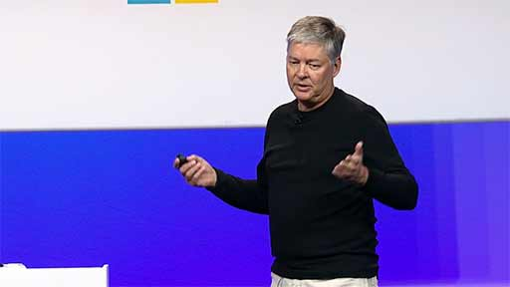
HISTORY
Anders Hejlsberg, lead architect of C# and worked on the development of TypeScript.
TypeScript was first made public in October 2012 (at version 0.8), after two years of internal development at Microsoft.
On 22 September 2016, TypeScript 2.0 was released.

Slide 6
WHAT IS TYPE SCRIPT
What is TypeScript?
TypeScript is a strongly typed, object oriented, compiled language.
TypeScript is both a language and a set of tools.
TypeScript is a typed superset of JavaScript compiled to JavaScript.
In other words, TypeScript is JavaScript plus some additional features.
TYPESCRIPT
JAVASCRIPT

Slide 7
WHY USE TYPESCRIPT?
The benefits of TypeScript include −
Compilation − JavaScript is an interpreted language. TypeScript will compile the code and generate compilation errors, if it finds some sort of syntax errors. This helps to highlight errors before the script is run.
Strong Static Typing − JavaScript is not strongly typed. TypeScript comes with an optional static typing and type inference system through the TLS (TypeScript Language Service). The type of a variable, declared with no type, may be inferred by the TLS based on its value.
TypeScript supports Object Oriented Programming concepts like classes, interfaces, inheritance, etc.

Slide 8
FEATURES
Features of TypeScript
TypeScript is just JavaScript. TypeScript starts with JavaScript and ends with JavaScript. Typescript adopts the basic building blocks of your program from JavaScript. Hence, you only need to know JavaScript to use TypeScript. All TypeScript code is converted into its JavaScript equivalent for the purpose of execution.
TypeScript supports other JS libraries. Compiled TypeScript can be consumed from any JavaScript code. TypeScript-generated JavaScript can reuse all of the existing JavaScript frameworks, tools, and libraries.
JavaScript is TypeScript. This means that any valid .js file can be renamed to .ts and compiled with other TypeScript files.
TypeScript is portable. TypeScript is portable across browsers, devices, and operating systems. It can run on any environment that JavaScript runs on. Unlike its counterparts, TypeScript doesn’t need a dedicated VM or a specific runtime environment to execute.

Slide 9
TYPESCRIPT AND ECMASCRIPT
The ECMAScript specification is a standardized specification of a scripting language. There are six editions of ECMA-262 published. Version 6 of the standard is codenamed "Harmony". TypeScript is aligned with the ECMAScript6 specification.
TypeScript adopts its basic language features from the ECMAScript5 specification, i.e., the official specification for JavaScript. TypeScript language features like Modules and class-based orientation are in line with the EcmaScript 6 specification. Additionally, TypeScript also embraces features like generics and type annotations that aren’t a part of the EcmaScript6 specification.
ECMASCRIPT5
ECMASCRIPT5
ADDITIONAL FEATURES
TYPESCRIPT

Slide 10
COMPONENTS OF TYPESCRIPT
TypeScript has the following three components:
Language − It comprises of the syntax, keywords, and type annotations.
Compiler − The TypeScript compiler (tsc) converts the instructions written in TypeScript to its JavaScript equivalent.
Language Service − The "Language Service" exposes an additional layer around the core compiler pipeline that are editor-like applications. The language service supports the common set of a typical editor operations like statement completions, signature help, code formatting and outlining, colorization, etc.

Slide 11
COMPONENTS OF TYPESCRIPT
language
compiler
Language service

Slide 12
DECLARATION FILES
Declaration Files
When a TypeScript script gets compiled, there is an option to generate a declaration file (with the extension .d.ts) that functions as an interface to the components in the compiled JavaScript.
The concept of declaration files is analogous to the concept of header files found in C/C++. The declaration files (files with .d.ts extension) provide intellisense for types, function calls, and variable support for JavaScript libraries like jQuery, MooTools, etc.

Slide 13
ENVIRONMENT SETUP
Local Environment Setup
Typescript is an Open Source technology. It can run on any browser, any host, and any OS. You will need the following tools to write and test a Typescript program −
A Text Editor
The text editor helps you to write your source code. Examples of a few editors include Windows Notepad, Notepad++, Emacs, vim or vi, etc. Editors used may vary with Operating Systems.
The source files are typically named with the extension .ts

Slide 14
ENVIRONMENT SETUP
The TypeScript compiler is itself a .ts file compiled down to JavaScript (.js) file. The TSC (TypeScript Compiler) is a source-to-source compiler (transcompiler / transpiler).
The TSC generates a JavaScript version of the .ts file passed to it. In other words, the TSC produces an equivalent JavaScript source code from the Typescript file given as an input to it. This process is termed as transpilation.
However, the compiler rejects any raw JavaScript file passed to it. The compiler deals with only .ts or .d.ts files.
app.ts
tsc app.ts
app.js

Slide 15

ENVIRONMENT SETUP
Installing Node.js
Node.js is an open source, cross-platform runtime environment for server-side JavaScript. Node.js is required to run JavaScript without a browser support. It uses Google V8 JavaScript engine to execute code. You may download Node.js source code or a pre-built installer for your platform.
Step 1 − Download and run the .msi installer for Node
Step 2 − To verify if the installation was successful, enter the command node –v in the terminal window.
Step 3 − Type the following command in the terminal window to install TypeScript.
npm install -g typescript

Slide 16
var message:string = "Hello World" console.log(message)
BASIC SYNTAX
Your First TypeScript Code
Let us start with the traditional “Hello World” example −
//Generated by typescript 1.8.10 var message = "Hello World"; console.log(message);

Slide 17
BASIC SYNTAX
On compiling, it will generate following JavaScript code.
//Generated by typescript 1.8.10 var message = "Hello World"; console.log(message);Line 1 declares a variable by the name message. Variables are a mechanism to store values in a program.
Line 2 prints the variable’s value to the prompt. Here, console refers to the terminal window. The function log () is used to display text on the screen.

Slide 18
COMPILE AND EXECUTE A TYPESCRIPT PROGRAM
Let us see how to compile and execute a TypeScript program using Visual Studio Code. Follow the steps given below −
Step 1 − Save the file with .ts extension. We shall save the file as Test.ts. The code editor marks errors in the code, if any, while you save it.
Step 2 − Right-click the TypeScript file under the Working Files option in VS Code’s Explore Pane. Select Open in Command Prompt option.
Step 3 − To compile the file use the following command on the terminal window.
Step 4 − The file is compiled to Test.js. To run the program written, type the following in the terminal.
tsc Test.ts
node Test.js

Slide 19
EXAMPLE
Test.ts
class Greeting {
greet():void {
console.log("Hello World!!!")
}
}
var obj = new Greeting();
obj.greet();
Test.js
var Greeting = /** @class */ (function () {
function Greeting() {
}
Greeting.prototype.greet = function () {
console.log("Hello World!!!");
};
return Greeting;
}());
var obj = new Greeting();
obj.greet();

Slide 20
CLASSES
TypeScript is object oriented JavaScript. TypeScript supports object-oriented programming features like classes, interfaces, etc. A class in terms of OOP is a blueprint for creating objects. A class encapsulates data for the object. Typescript gives built in support for this concept called class.
Creating classes
Use the class keyword to declare a class in TypeScript. The syntax for the same is given below −
Syntax:
class class_name {
//class scope
}

Slide 21
CLASSES
Example: Declaring a class
class Car {
//field engine:string; //constructor constructor(engine:string) {
this.engine = engine
} //function
disp():void { console.log("Engine is : "+this.engine)
}
}
//Generated by typescript 1.8.10
var Car = (function () { //constructor
function Car(engine) { this.engine = engine;
}
//function Car.prototype.disp = function () { console.log("Engine is : " + this.engine); };
return Car;
}());

Slide 22
MODULES
A module is designed with the idea to organize code written in TypeScript. Modules are broadly divided into −
Internal Modules
External Modules
Internal Module:
Internal modules came in earlier version of Typescript. This was used to logically group classes, interfaces, functions into one unit and can be exported in another module. This logical grouping is named namespace in latest version of TypeScript.

Slide 23
Internal Module Syntax:
MODULES
namespace snipe community{
export function add(x, y) { console.log(x + y);}
}
JavaScript generated in both cases are same:
var snipe community;
(function (snipe community){
function add(x, y)
{ console.log(x + y);
} snipe community.add = add;
})(snipe community || (snipe community = {}));

Slide 24
MODULES
External Module:
External modules in TypeScript exists to specify and load dependencies between multiple external js files. If there is only one js file used, then external modules are not relevant. Traditionally dependency management between JavaScript files was done using browser script tags (<script></script>).
Syntax-
//FileName : SomeInterface.ts
export interface SomeInterface {
//code declarations
}

Slide 25
MODULES
External Module:
Example
/ IShape.ts
export interface IShape {
draw();
} // Circle.ts
import shape = require("./IShape");
export class Circle implements shape.IShape {
public draw()
{ console.log("Cirlce is drawn (external module)");
}
} // Triangle.ts
import shape = require("./IShape");
export class Triangle implements shape.IShape {
public draw() { console.log("Triangle is drawn (external module)"); }
}
// TestShape.ts
Import shape = require("./IShape");
import circle = require("./Circle");
import triangle = require("./Triangle");
function drawAllShapes(shapeToDraw: shape.IShape) {
shapeToDraw.draw();
}
drawAllShapes(new circle.Circle());
drawAllShapes(new triangle.Triangle());

Slide 26
MODULES
The command to compile the main TypeScript file for AMD systems is −
On compiling, it will generate following JavaScript code for AMD.
File:IShape.js
tsc --module amd TestShape.ts
//Generated by typescript 1.8.10
define(["require", "exports"], function (require, exports) { });

Slide 27
MODULES
File:Circle.js
define(["require", "exports"], function (require, exports) { var Circle = (function () {
function Circle() {
} Circle.prototype.draw = function () {
console.log("Cirlce is drawn (external module)");
};
return Circle;
})();
exports.Circle = Circle;
});

Slide 28
MODULES
File:Triangle.js
define(["require", "exports"], function (require, exports) {
var Triangle = (function () {
function Triangle() {
}
Triangle.prototype.draw=function () {
console.log("Triangle is drawn (external module)");
};
return Triangle;
})();
exports.Triangle = Triangle;
});

Slide 29
CONCLUSION
TypeScript lets you write JavaScript the way you really want to. TypeScript is a typed superset of JavaScript that compiles to plain JavaScript. TypeScript is pure object oriented with classes, interfaces and statically typed like C# or Java. The popular JavaScript framework Angular 2.0 is written in TypeScript. Mastering TypeScript can help programmers to write object-oriented programs and have them compiled to JavaScript, both on server side and client side.

Slide 30
THANK YOU

